Slide 1
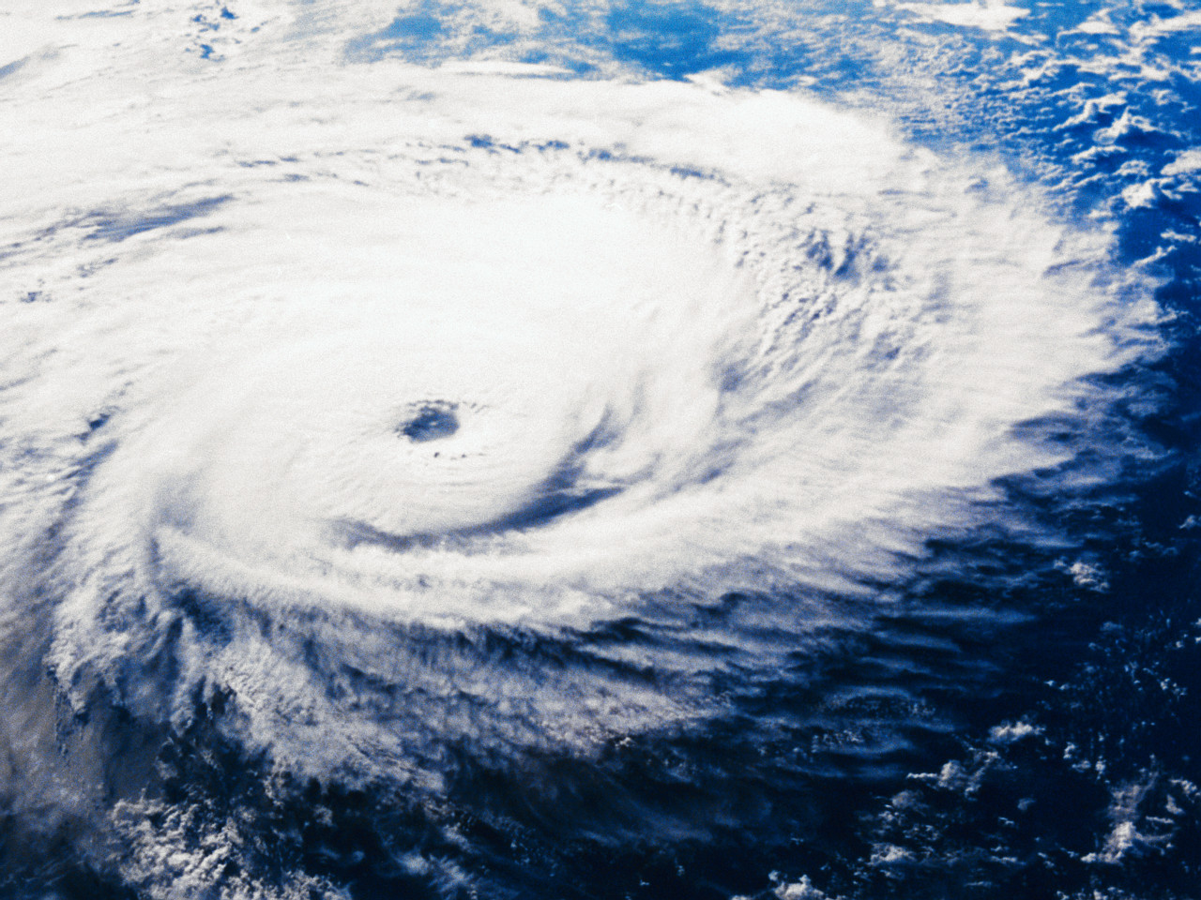
Hurricane models & tracking

Slide 2
How are hurricanes formed?
A hurricane is a system of low pressure that originates over a tropical area.
There are specific conditions that must be present in order for a hurricane to develop:
Warm waters (at least 80F) thru a depth of about 150 ft.
A rapidly cooling, unstable atmosphere
Moist air near the troposphere
At a minimum distance of 300 miles from the equator
A pre-existing, near-surface disturbance
Low, vertical, wind shear (less than 23 mph)

Slide 3
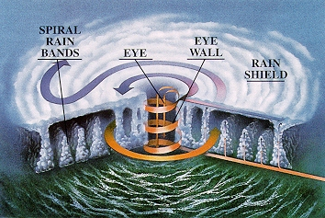
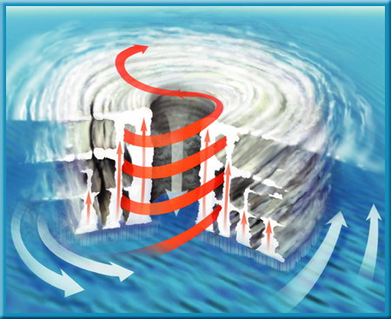
Parts of the Hurricane

Slide 4
Hurricane Hunters
Hurricane Hunters are specialized planes part of the U.S. Air force assigned to gather information about tropical storms. They are primarily stationed in Biloxi, Mississippi but sometimes take off from Miami. When they depart, they head straight INTO the center of the hurricane. Their information is then sent to the National Hurricane Center where it is fed into the computer forecast models so that a prediction can be made!
During their off season, the hurricane hunters join the Air Force reserve and fulfill and wide range of operational missions

Slide 5
Instruments used to collect information
The hurricane hunters use a device called a GPS sonar to find the air pressure, temperature, wind speed, and humidity. We use the following instruments in meteorology to find the same information:
Barometer: Air pressure
Thermometer: temperature
Anemometor: measure wind speed
Wind vane: measure wind direction (all winds must be in the same direction for a hurricane to form)
Hygrometer: humidity

Slide 6
National Hurricane Center
The National Hurricane Center is responsible for developing a forecast track and issuing any advisories or warnings. They use the information from the Hurricane Hunters GPS sonar.
Tracking: in order to create a possible hurricane track, the NHC takes into consideration all conditions surrounding the hurricane such as high and low pressure systems that can change the details of the hurricane. Try it out for your self!!! Hurricane Tracks for Idealized Environmental Flows

Slide 7
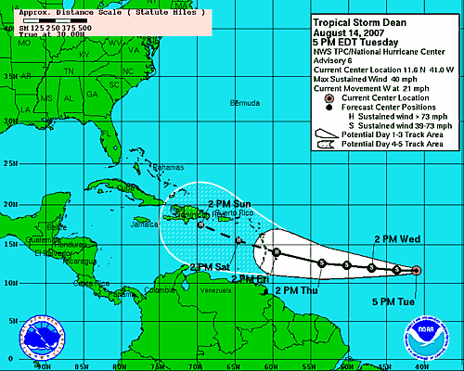
How do we know where the hurricane is going?
Dynamical Models: numerical model that uses physics to solve equations of motion in the atmosphere
Statistical Models: based on historical relationships between storm behavior and storm specific details (location & date)
Statistical Dynamical Model: combines both physics and history to create a forecast model
Forecast Models

Slide 8
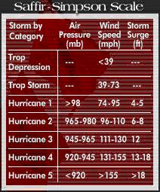
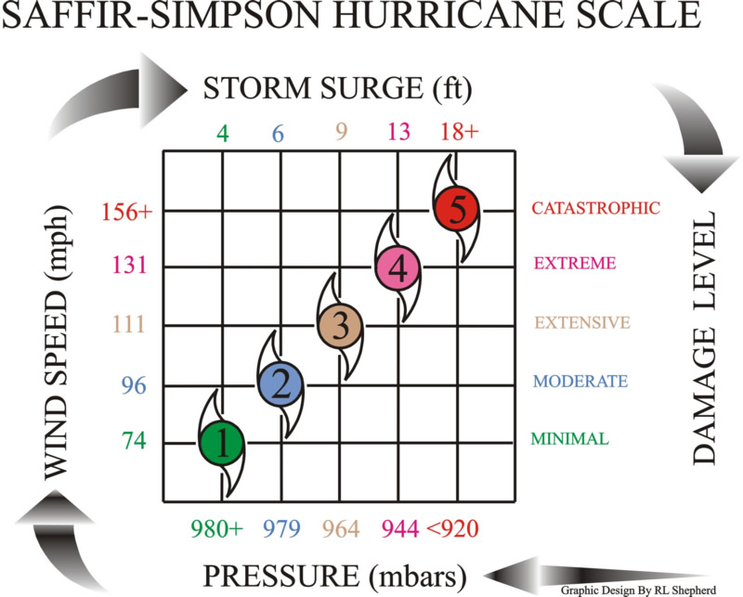
Saffir Simpson Scale
The Saffir-Simpson Scale has been updated to only reflect wind speed due to the in-accuracies that air pressure and storm surge represent
Although the Saffir-Simpson Scale no longer uses pressure and storm surge it is still a vital component of the tracking and forecast process

Slide 9
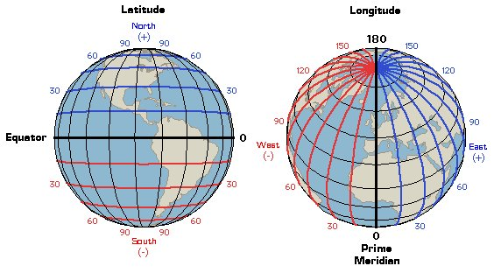
Tracking at Home!
We can track the path of a hurricane at home if we know how to use a map to find coordinates.
Longitude lines are those that run vertically (up and down) use east and west to describe. Ex. y axis
Latitude lines are those that run horizontally (side to side) use north and south to describe. Ex. X axis
When you write coordinates you first write latitude first then longitude. You must also include direction (N,S, E, W) because there are two of every coordinate; above and below the equator
Let’s practice (80W, 25N) (70W, 19N)

Slide 10
So let’s put it all together
We have learned that the ______ the air pressure the stronger the storm is
Humidity and heat makes the storm ________
There are ____ different types of forecast models
What is the instrument used to measure wind direction? Wind speed?
Let’s practice!! Create-a-Cane

