Slide 1
The Four branches of Earth Science

Slide 2
What is Earth Science
The scientific study of Earth and the universe around it.
Chinese began keeping records of Earthquakes as early as 780 BCE
Ancience greeks compiled a catalog of rocks and minerals around 200 BCE

Slide 3
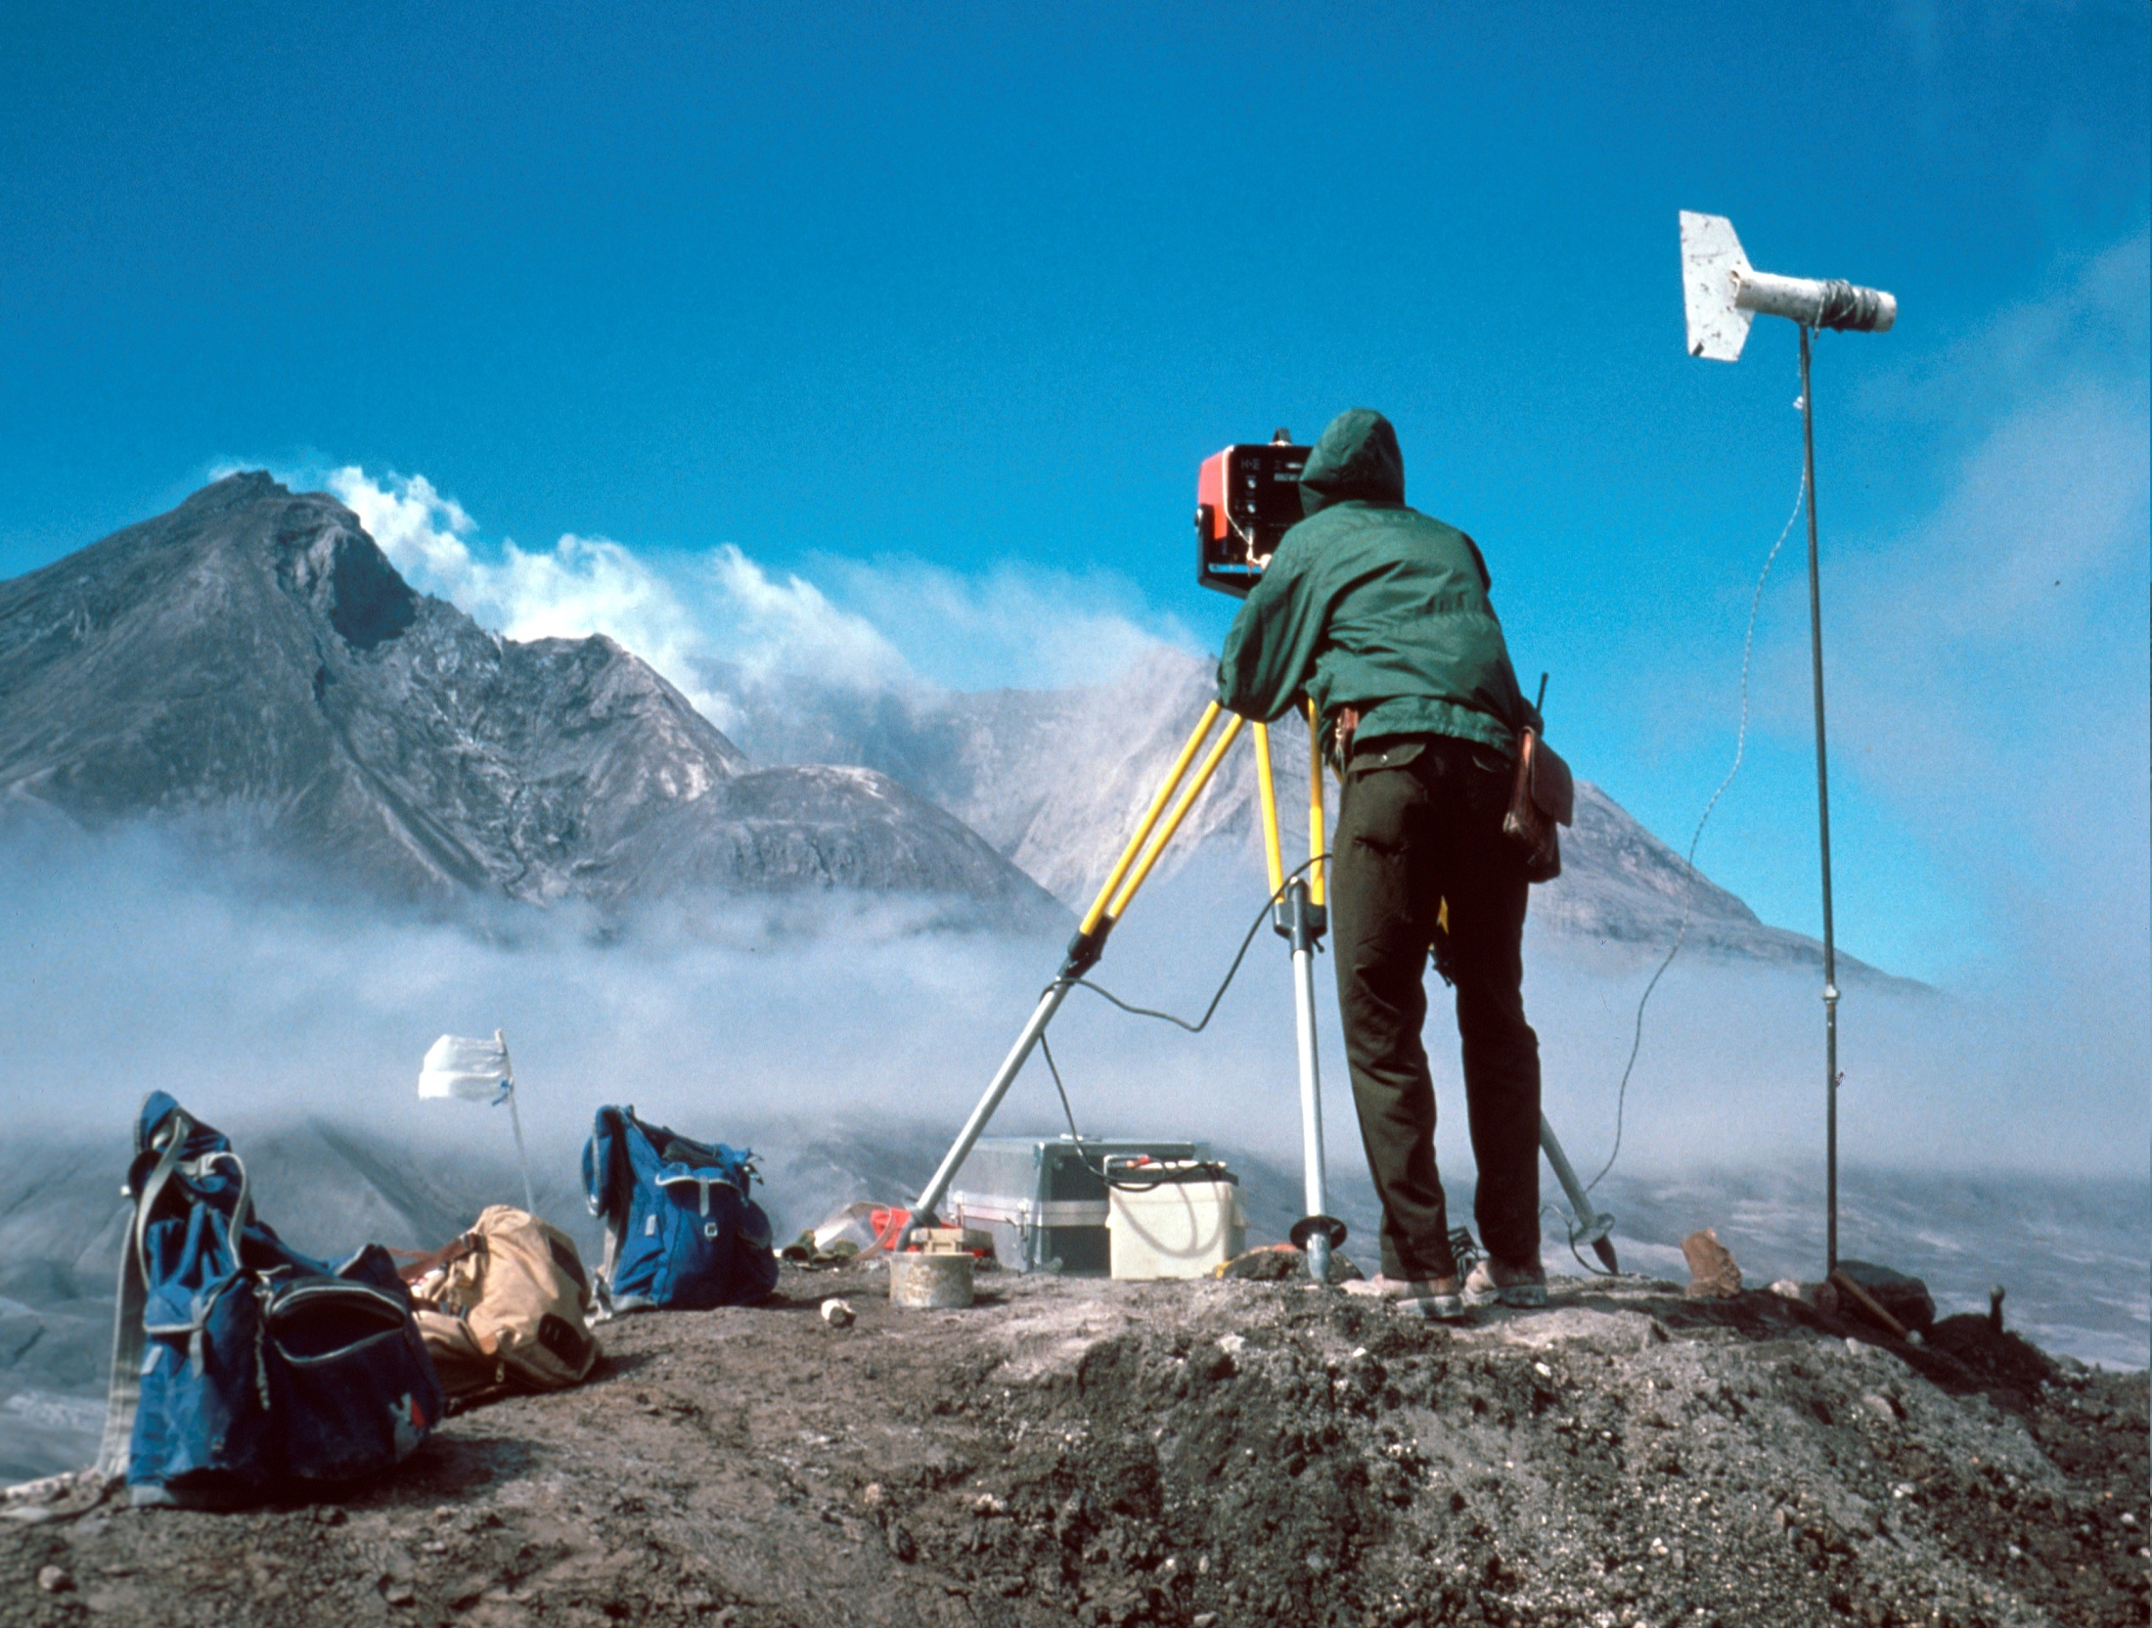
Geology
The scientific study of the origin, history, and structure of Earth and the Processes that shape Earth
Can study crust deposits, forces within Earth to predict earthquakes and volcanic eruptions and can study fossils to learn more about Earth’s past

Slide 4
Oceanography
Study of the ocean, including the properties and movements of ocean water, the characteristics of the ocean floor and the organisms that live in the ocean.
Oceans cover 3/4ths of the Earths surface
Oceanographers study waves, tides, ocean currents, and the sea floor to obtain clues to Earths history or locate mineral deposits

Slide 5
Meteorology
The scientific study of Earths atmosphere, especially in relation to weather and climate
Meteorologist create detailed weather maps or can make weather forecasts.
Some study Climate which are the patterns of weather that occur over long periods of time.

Slide 6
Astronomy
The scientific study of the universe
It is the oldest study of Earth science, babyloninas charted the positions of planets 4000 years ago.

Slide 7
Measurement
Accuracy vs. Precision Measurements are accurate when they are close to the true value Measurements are precise when they are close to each other

Slide 8
Measurement
Accuracy vs. Precision Measurements can be accurate but not precise Measurements can be precise but not accurate

Slide 9
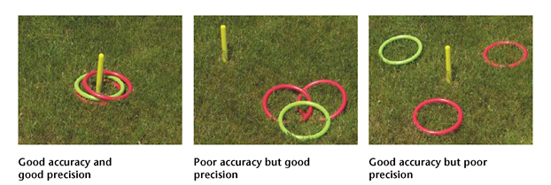

Slide 10
Measurement
English units of measure 12 inches = 1 foot 3 feet = 1 yard 1760 yards = 1 mile 2 cups = 1 pint 2 pints=1 quart 4 quarts = 1 gallon 16 ounces (dry) = 1 pound 2000 pounds = 1 ton Converting between units is not standard, you must know all multipliers

Slide 11
Derived Units of Measurement
Measurement Unit Name Symbol Units Area square meter m² m² Volume cubic meter m³ m³ kiloliter kL m³ Speed m/s m/s Acceleration m/s² m/s² Momentum kg·m/s kg·m/s Force Newton N kg·m/s² Pressure Pascal Pa kg/m·s² Energy Joule J kg·m²/s²

Slide 12
Scientific Notation
Numbers in science vary greatly Speed of light = 300,000,000 m/s Mass of electron = 0.000 000 000 000 000 000 000 000 000 9g To express these more easily, we use scientific notation Express as a number with only one digit to the left of the decimal times 10 raised to an exponent Examples Speed of light = 3 x 10⁸ m/s Mass of electron = 9 x 10⁻²⁸ g

Slide 13
Scientific Notation
To multiple two numbers in scientific notation, ignore the units, multiply the numbers, then add the exponents 3x10⁸ m/s x 3x10⁸ m/s = (3 x 3) x 10⁸⁺⁸ = 9 x 10¹⁶ m²/s²

Slide 14
Scientific Notation
To divide two numbers in scientific notation, ignore the units, divide the numbers, then subtract the exponents 4.5 x 10⁵ kg / 1.5 x 10³ kg = (4.5/1.5) x 10⁵⁻³ = 3 x 10²

Slide 15
Scientific Notation
Multiply 2.7 x 10¹ m/s by 1 x 10³ kg Momentum of 2205 lb car moving at 60 mi/h (in kg m/s) Divide 6 x 10²⁴ kg² by 4.096 x 10¹² m² Multiply the result by 6.67 x 10⁻¹¹ m³/kg s² Force between the Earth and a 1 kg mass at the surface (in newtons)

Slide 16
Scientific Notation
Multiply 2.7 x 10¹ m/s by 1 x 10³ kg (2.7 x 1) x 10⁽¹⁺³⁾ x kg x m/s = 2.7 x 10⁴ kg m/s Divide 6 x 10²⁴ kg² by 4.096 x 10¹² m² Multiply the result by 6.67 x 10⁻¹¹ m³/kg s² (6 / 4.096) x 6.67 x 10⁽²⁴⁻¹²⁺⁻¹¹⁾ x kg²/m² x m³/kg s² = .977 x 10¹ x kg m/s² = 9.77 x 10⁰ kg m/s²

Slide 17
S.I. The International System of Units
Why Earth and why hands?

Slide 18


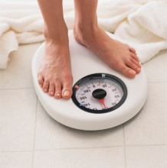
What does it measure? Pg 870
S.I. Unit | What it measures | American Equivalent | Some pictures to help us remember
Meter | Length or distance | Yard, mile, feet, centimeters millimeters | ---------→
Liter | Volume of liquids and gases | Gallon, ½ gallon, pint, cup, teaspoon, tablespoon | ----------→
Grams | Mass | Pound and ounces | -----------→

Slide 19
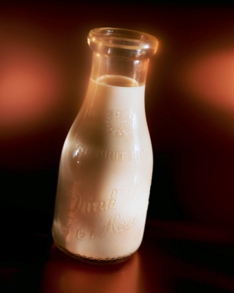
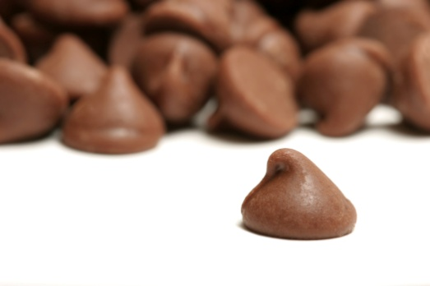

K.H.D.D.C.M.
HENRY
H
E
N
R
Y
C
H
O
C
O
La
T
E
D
I
E
D
D
R
I
N
K
I
N
G
M
I
L
K
K
I
N
G

Slide 20

K.H.D.D.C.M. this is used with all three basic units
HENRY
H
E
C
T
A
D
E
C
A
K
I
L
O
D
E
C
I
C
E
N
T
I
M
I
L
L
I

Slide 21

K.H.D.D.C.M.
Kilo 1000
Hecta 100
Deca 10
UNIT 1
Deci .10
Centi .010
Mili .0010

Slide 22
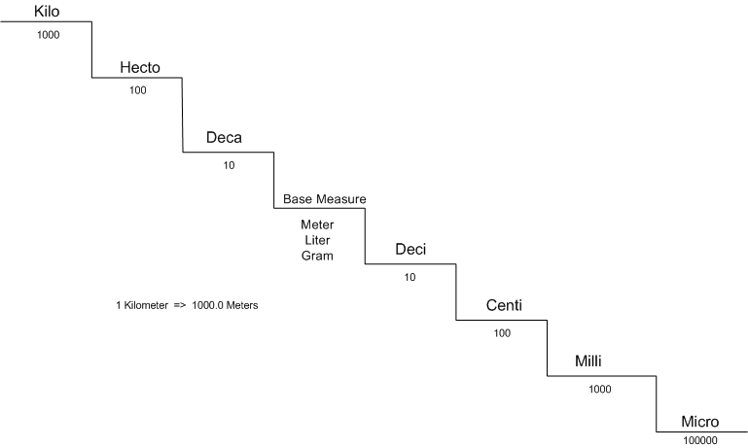
K.H.D.D.C.M.
Lets come up with some examples

Slide 23
Practice worksheet

Slide 24
Graphing
Types of Graphs: line, Bar, Circle
Required components: Title, Labels, Units, Scale
Pg 824

Slide 25
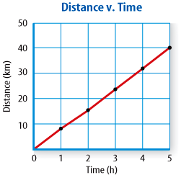
Line Graphs
A line graph shows a relationship between two
variables that change continuously.

Slide 26
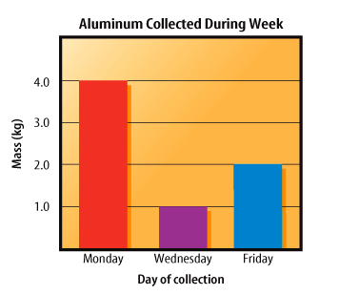
Bar Graphs
A bar graph compares data that do not change continuously

Slide 27
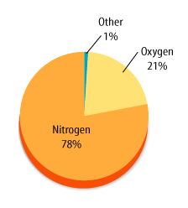
Circle Graph
Percentage of Gases in Atmosphere
A circle graph displays data as parts of a whole

Slide 28
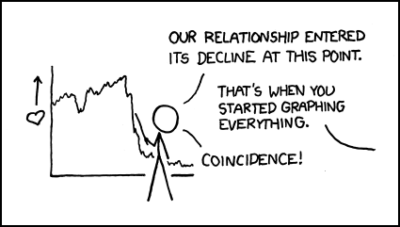
When graphs are misused…

Slide 29
Trend Lines
Best fit line Solving Trend Lines

