Slide 1
Attraction, Repulsion, and Static Electricity

Slide 2
Energy Levels
Electrons are arranged in different levels with in the electron cloud. There is a specific rule as to how many electrons can fit in each level of an electron.
In order to calculate how many electrons an energy level will have use the formula 2n^2 where n= energy level
Ex how many electrons in 5 energy levels
2 (5^2) = 50

Slide 3
attraction
Some elements are attracted to others and mesh well with others while some do not.
Attraction is very similar to attraction among humans, you are attracted to a person who you feel completes you or complements you.
Atoms are the same. They are attracted to other atoms that complete them.
What completes an atom is called bonding

Slide 4
Repulsion
Repulsion is exactly the opposite of attraction. Some atoms are just not meant to be together because they are too similar or to completely opposite.
When two atoms repel each other there is usually a large amount of energy transferred.
A common example of this is static electricity.
Electro static Generator

Slide 5
How bonding or repulsion happens
Bonding or repulsion has to do with the electrons that an atom has.
When I said they complete each other I literally meant it. Some atoms are incomplete with out other atoms. You can see this in their electron cloud.

Slide 6
Bonding and Valences
The position of electrons around the nucleus of the atom is called valences.
The electron cloud is organized like floors in a building. Each floor (or shells) can hold a certain maximum number of electrons.
The first shell holds two. The shell floor holds 8.
The farther away from the nucleus an electron is, the easier it is to remove it from the atom.
When atoms bond, open spaces in their valences allow the atoms to fit together like puzzle pieces.

Slide 7
How to draw an orbital diagram
Having a complete outer shell makes an atom stable.
Any atom can become stable if it has 8 electrons in its outer most shell.

Slide 8
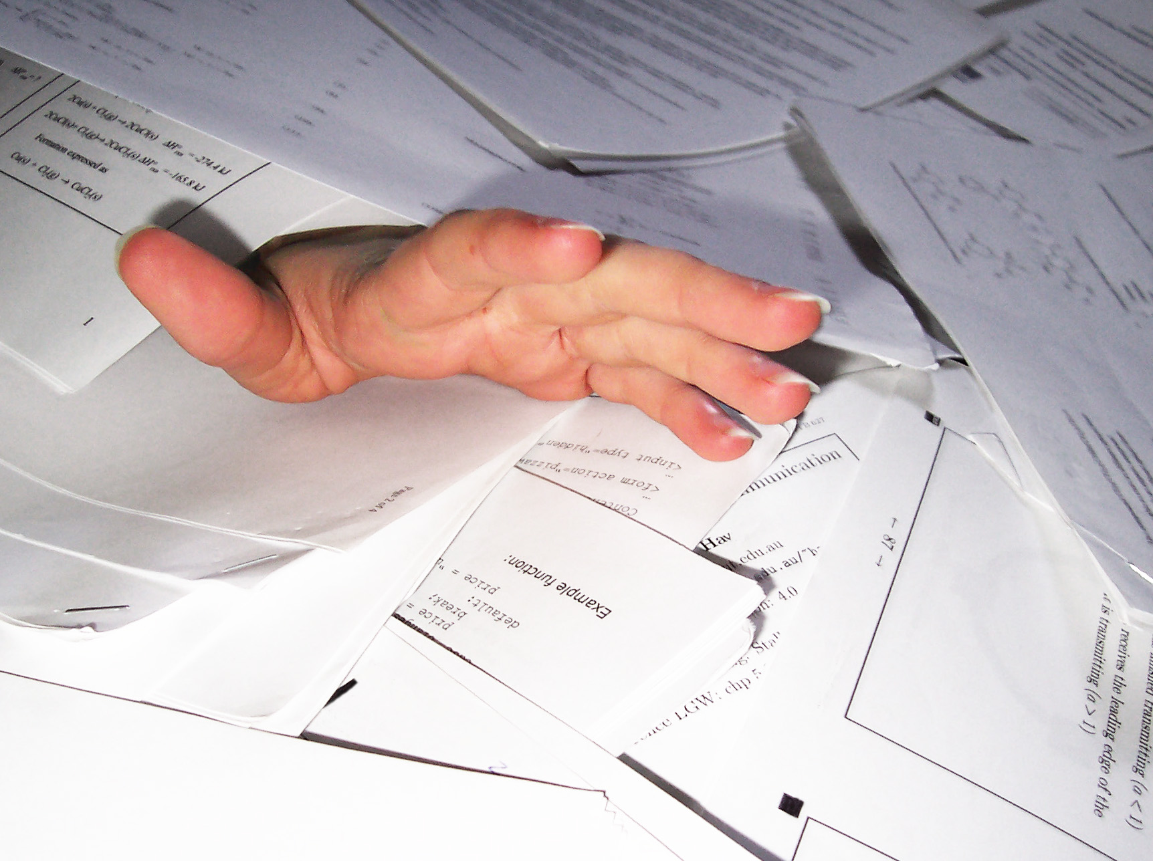
A way to organize elements
The periodic table

Slide 9
How it’s organized
The elements are organized on the periodic table by their properties.
There are rows and columns that represent relationships between the elements.
The rows are called periods. There are seven of them. The elements in these rows share the same number of shells in their electron cloud. Ex. Hydrogen and Helium are in the first shell so each of them has only one shell of electrons.
The columns are called groups. Elements in the same group share the same number of electrons in their outer most shell. Ex. Group 2 have 2 electrons in their outer most shell.
Colors distinguish families.
where do i belong?

Slide 10
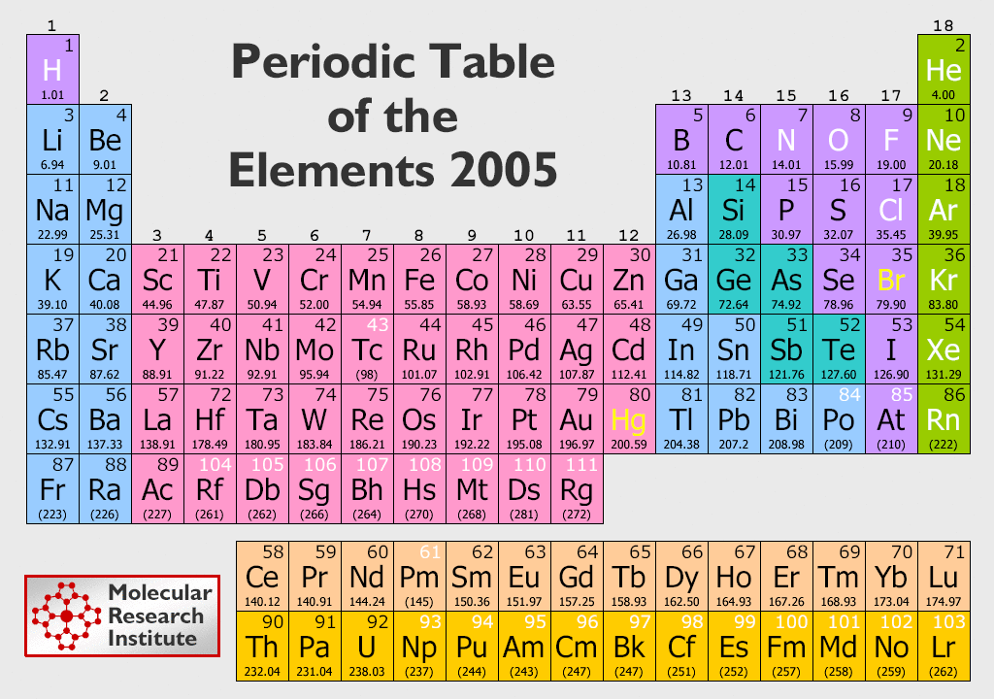

Slide 11
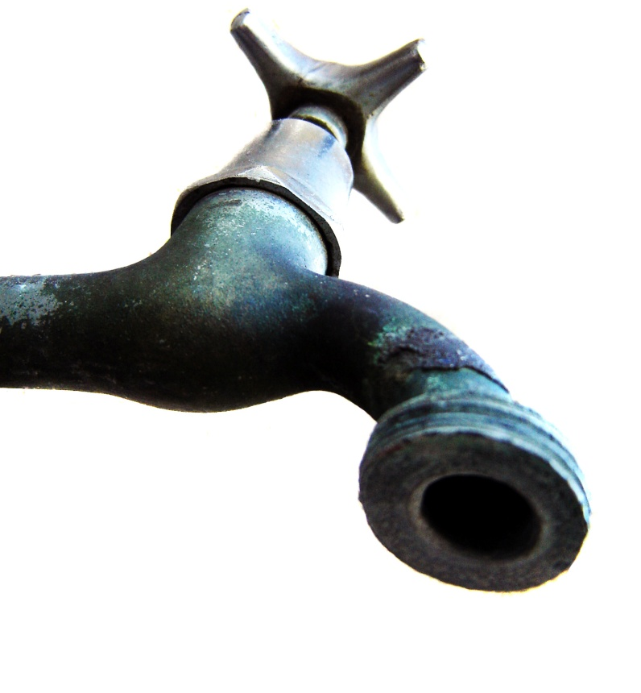
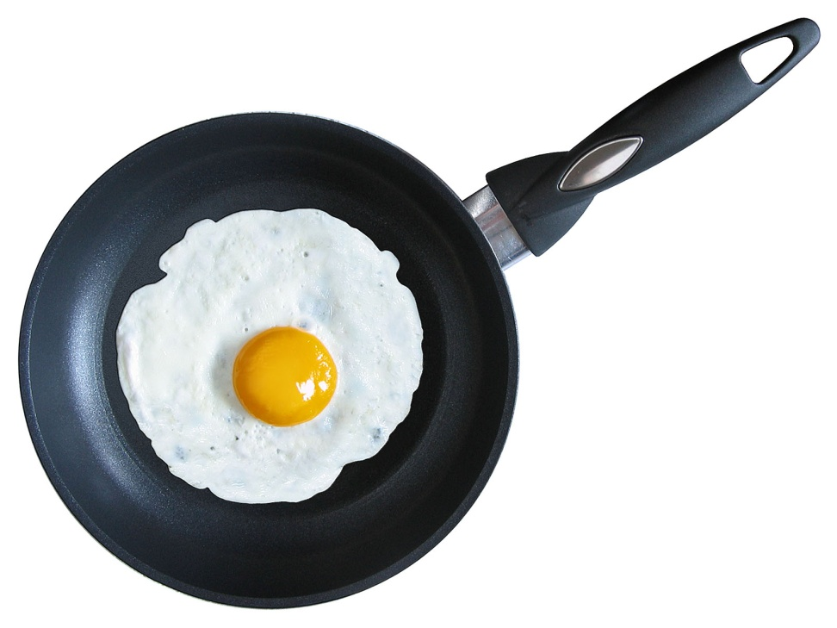
Classification of elements
Metals:
Usually shiny
Good conductors of electricity
Nearly all solid at room temperature
Malleable (bent easily)
Ductile (pulled into wires without breaking)
Pg 328 in your book

Slide 12
Nonmetals
Usually dull in appearance
Poor conductors of electricity
Many are gasses
Solids break easily and cannot change shape easily
Except for hydrogen all are found on the right side of the periodic table
Pg 335 - 338

Slide 13
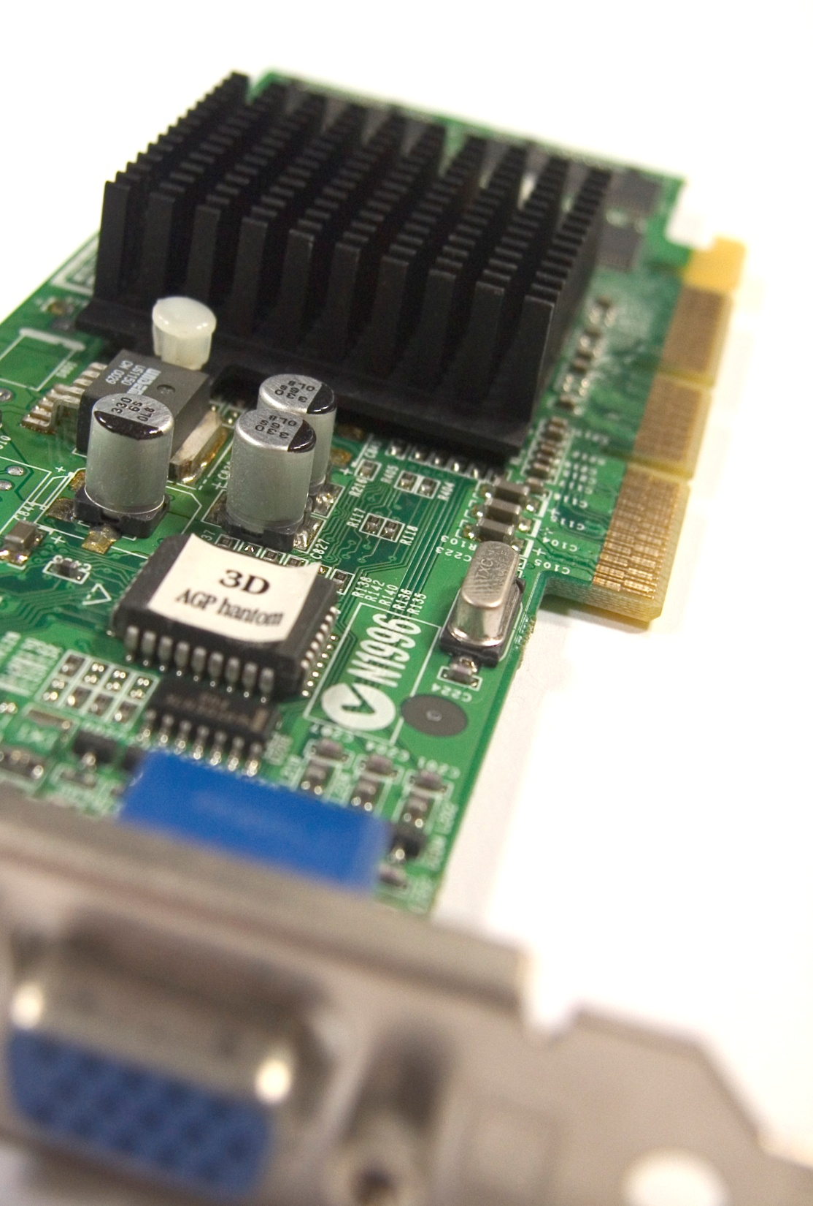
Metaloids
Have characteristics of nonmetals and metals
Not as good conductors as metals but better than non-metals
All are solids
339-341

Slide 14
Bonding and Valences
Elements have different qualities. These qualities come from how the atoms in those elements are organized
When two atoms join together it is called bonding.
Two or more atoms bonded together are called molecules.
When atoms bond they share electrons. The number of electrons and the position of the electrons determines which atoms can bond together.

Slide 15
How Elements bond

Slide 16
Ionic bonds
Atoms form bonds with other atoms using the electrons in their outer energy levels.
These bonds are very strong and do not fall apart. Ex NaCl = sodium chloride; salt
There are 4 ways that atoms can bond:
Losing electrons
Gaining electrons
Pooling electrons
Sharing electrons

Slide 17
Bonding
Na, sodium, has 1 electron in its outer most shell
Cl, chlorine, has 7 electrons in its outer most shell
Both are unstable and need to complete each other, they are a perfect match!!!
How Ions form

Slide 18
Opposites attract!!!
If an atom looses an electron it now becomes positively charged
If an atom gains an electron it is now negatively charged.
When you have oppositely charged ions close together, a type of chemical bond called an ionic bond is formed.

Slide 19
Metallic bonding- pooling
Metals do not give away their electrons instead they share them
Metallic bonds from when metal atoms share their pooled electrons.
Metallic bonding is the reason metals can bend and can conduct electricity well.

Slide 20
Covalent bonds- sharing
Some atoms are unlikely to loose or gain electrons because of the amount of energy it would take.
So instead of giving up their electrons they share!
Covalent bonds are chemical bonds that form between nonmetal atoms when they share electrons. The elctrons move back and forth between the two atoms.
Because they are sharing electrons their charge DOES NOT CHANGE so they are NOT IONS!!!
Because they are not ions, the bond they create is called a molecule
Diagram on pg 139

Slide 21
Polar and non-polar molecules
Atoms don’t always share equally. Some atoms are stronger than others and take over the electrons they are sharing so a great majority of them spend more time on one side than the other.
This un-even sharing of electrons makes the bond split in charge like the poles on a battery.
A polar bond is a bond in which electrons are shared unevenly.

Slide 22
Polar water molecule
Water molecules form when hydrogen (H) and oxygen (0) share electrons
pg 141, figure 19 shows how the oxygen atom has a greater share of the electrons in each bond. The oxygen end of the water is slightly negative and the hydrogen is slightly positive.
Because of this, water is said to be polar, having two opposite end or poles like a magnet.
Molecules that do not have these uneven charges are called non-polar molecules, this only happens in bonds of the same element.
atomic bonding

